Slide 1
EVENT-BASED DATA ASSURANCE
WORKSHOP #4: ONTOLOGY (3)
26th February 2020

Slide 2
Workshop schedule
W/s | Date | Deliverable | Agenda | Attendees
KO | 29/01 1-4pm | Common understanding | Questions Problem statements Expressions of interest | FB Technical Architect HMRC Technical Architect HMRC Innovation Lead
#1 | 05/02 1-4pm | Standards | Standards to implement and communicate shared knowledge base used in event-based data assurance
#2 | 12/02 1-4pm | Metadata model | Reasoning models for data assurance Classification Events Chains / sequences / methods Actors (e.g. source of events) Relationships (e.g. linking IDs) Supporting metadata Schema / headers Mandatory Optional
#3 | 19/02 1-4pm
#4 | 26/02 2-5pm
#5 | 04/03 1-4pm | Expert input | Expert assessment of proposed standards and metadata model | Representatives of Inrupt, Oxford Semantic Tech
#6 | 11/03 1-4pm | Rules of engagement | Boundary of open alliance Scalable / mutual contractual agreements for value exchange Value exchange mechanisms Publication of / subscription to events Permissioning (including consent) Use of standards and metadata model Governance | HMRC Innovation Lead HMRC Stakeholders x2 GDS representative(s)
#7 | 18/03 1-4pm
#8 | 25/03 9am-12

Slide 3
Agenda
Recap from Workshop 3 14.00 – 14.10
GitHub repository 14.10 – 14.30
Systems Context – from simple to complex 14.30 – 15.45
‘Refining’ Events – from simple to complex 15.45 – 16.45
Look forward to Workshop #5 16.45 – 17.00

Slide 4
Section 1
Recap from Workshop 3

Slide 5
OEF architecture constraints
Systems Thinking to provision for evolving ecosystems
API First
Negotiable protocols and resource representations
Event information exchange model agnostic
Event pipeline technology agnostic through a standard/specification for events
Observable at design time and run time, message passing (channels)

Slide 6
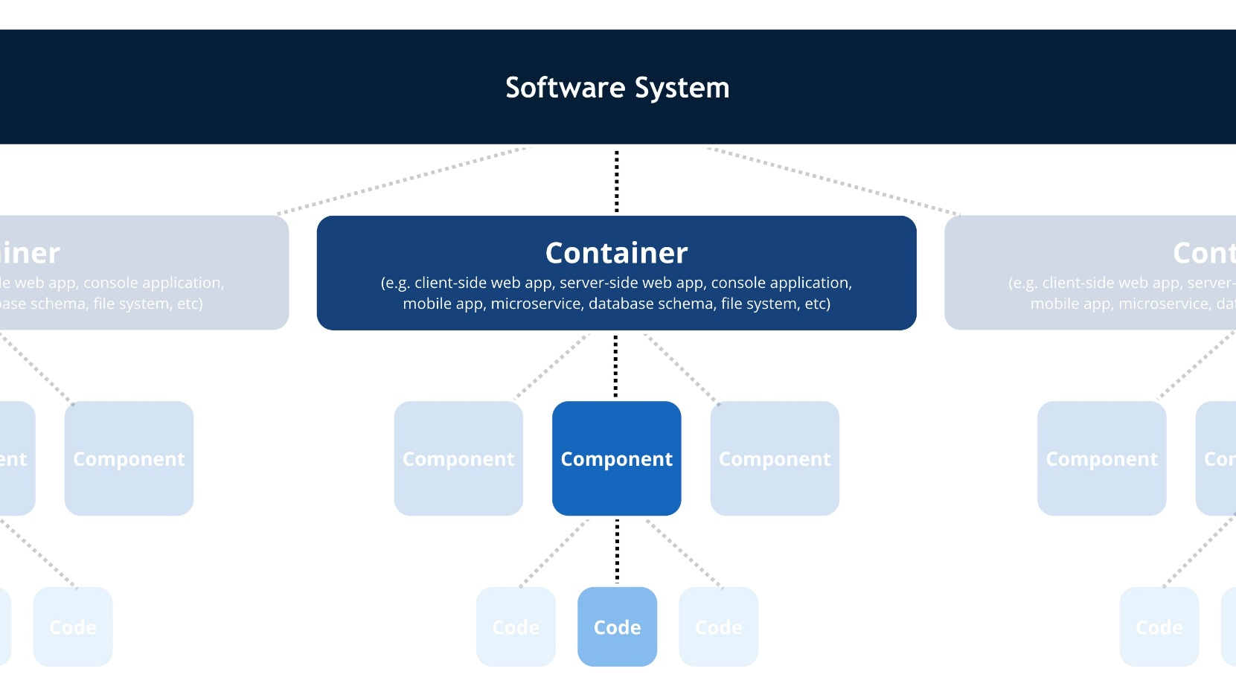
Systems Thinking – C4 model
“A common set of abstractions to create a ubiquitous language to use to describe the static structure of a software system.”

Slide 7
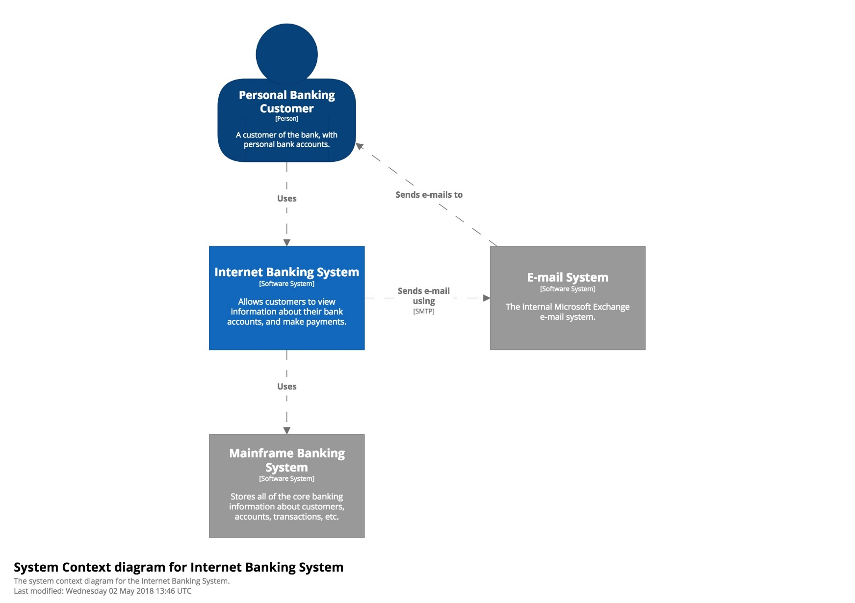
Systems Thinking – C4 model
1. System Context Diagram
Source: https://www.infoq.com/articles/C4-architecture-model/

Slide 8
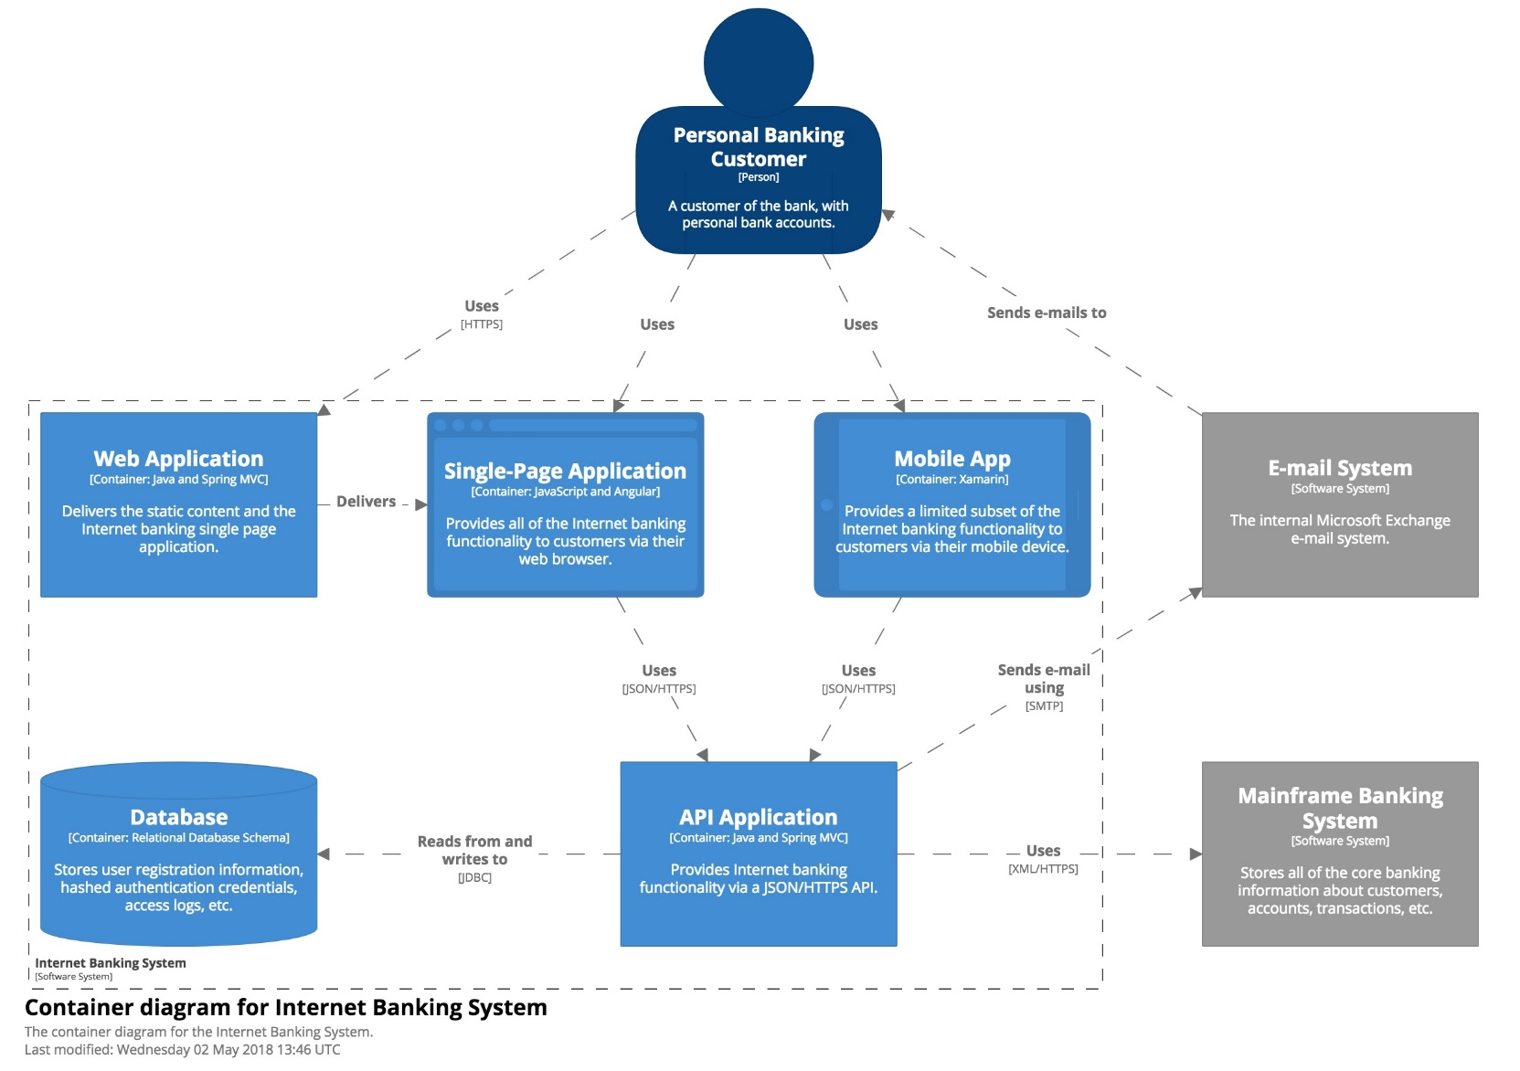
Systems Thinking – C4 model
2. Container Diagram
Source: https://www.infoq.com/articles/C4-architecture-model/

Slide 9
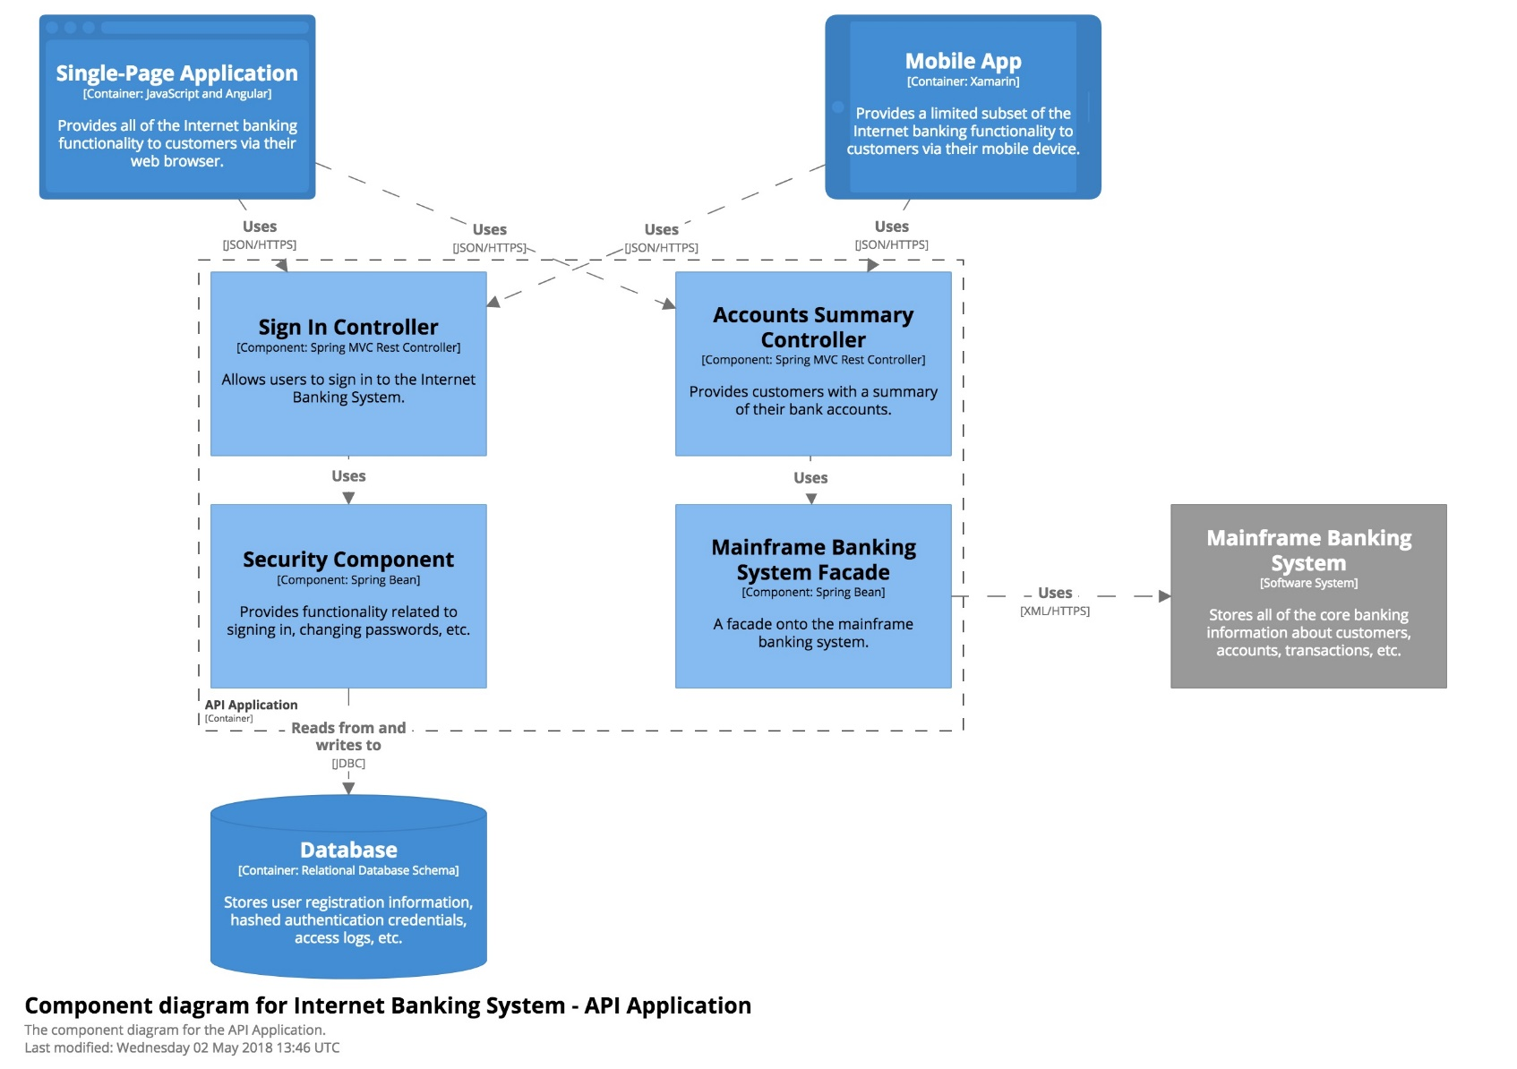
Systems Thinking – C4 model
3. Component Diagram
Source: https://www.infoq.com/articles/C4-architecture-model/

Slide 10
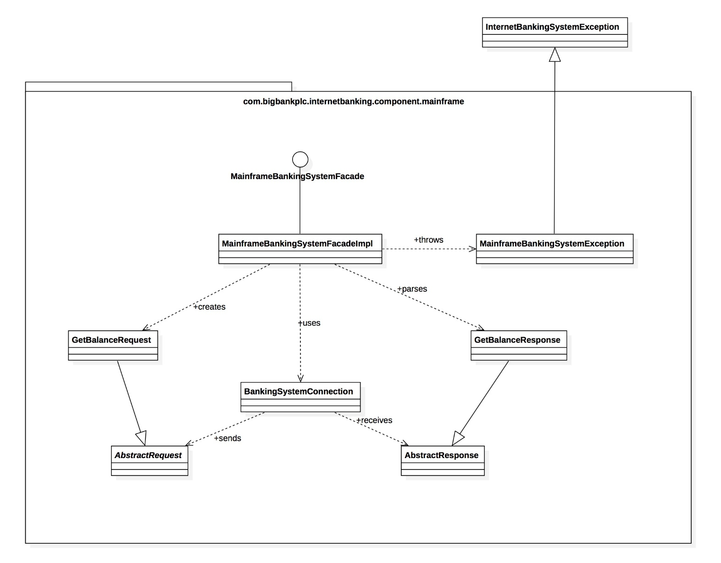
Systems Thinking – C4 model
4. Code Diagram
Source: https://www.infoq.com/articles/C4-architecture-model/

Slide 11
Section 2
GitHub repository

Slide 12
GitHub updates
Files uploaded
Workshop presentations added
Workshop meeting notes TBC – please review and sign off
Wiki
Glossary: an initial set of terms added – we need to converge these quickly
High Level Domain: configuration of ship has been added – any more domain knowledge?
Significant Events: organised by agency – please add agency-specific event types
Draft Ontology: re-worked to reflect high level domain – please review and comment
Draft Specification: initial draft of responsibilities – terminology needs to be aligned with systems context diagram

Slide 13
Section 3
System Context Diagram
– from simple to complex

Slide 14
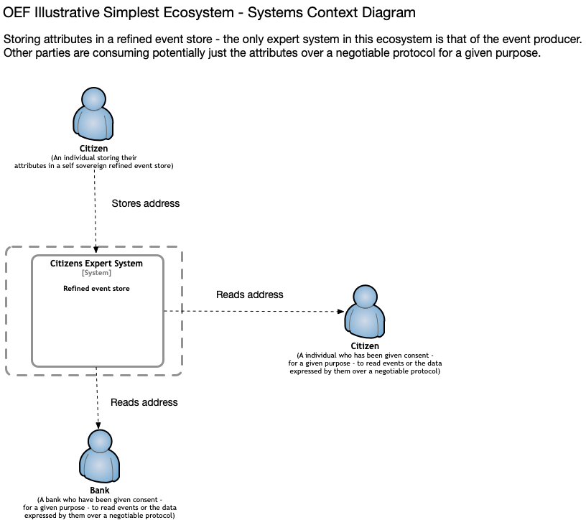

Slide 15
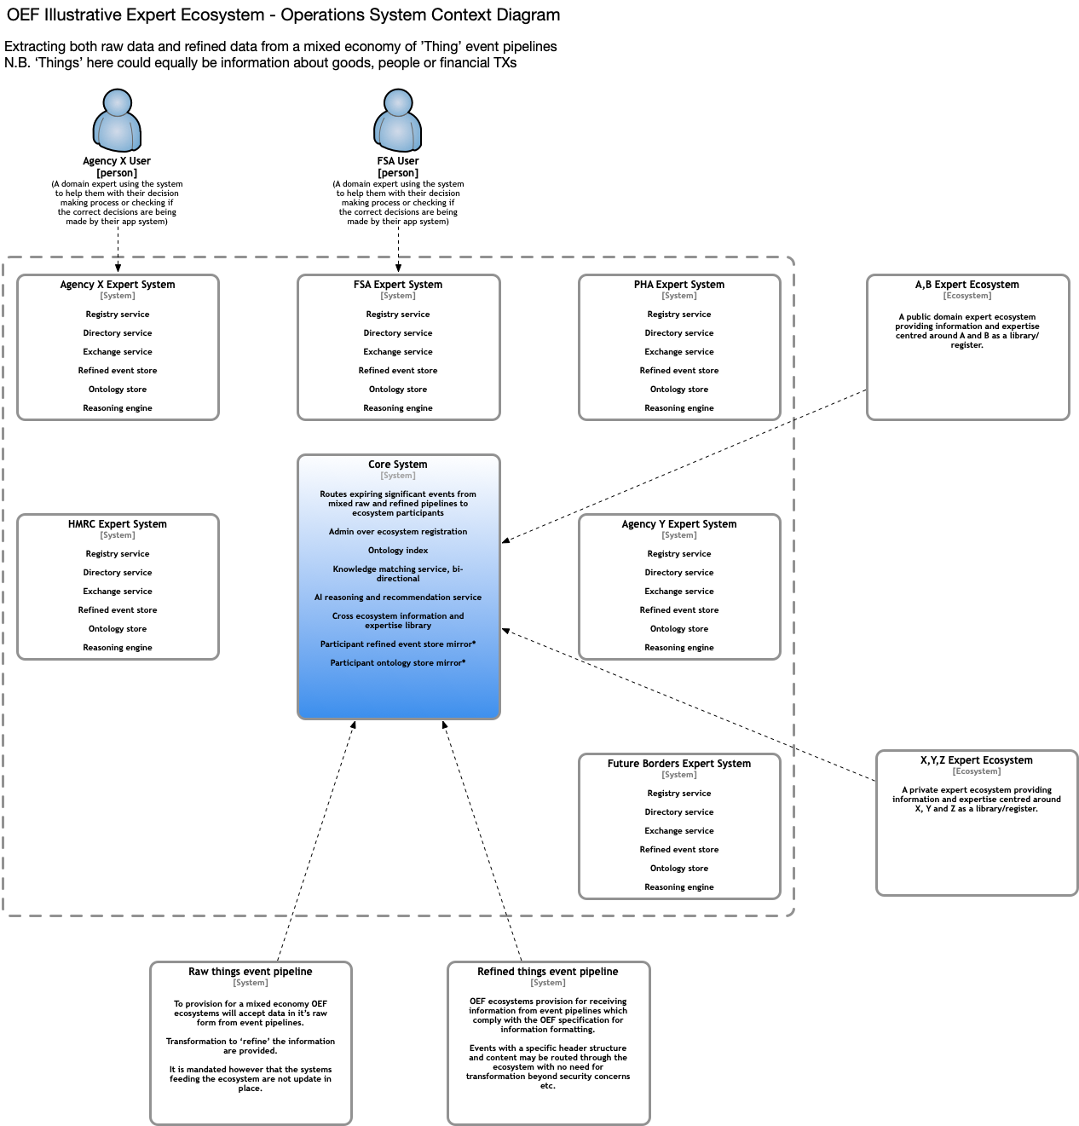

Slide 16
Section 4
‘Refining’ Events
- From simple to complex

Slide 17
What do we need to know about an Event?
When was it made?
Who made the statement?
Where was the statement originally made?
How do we verify the internal integrity of the statement?
Bare Event Elements | Description
Subject
Predicate
Object
Account Key | Corresponds to the speaker account of the fact. This the public part of the account’s key-pair.
Timestamp | The time when the fact was created
Node Key | Corresponds to the node through which the fact entered the OEF ecosystem. This the public part of the node’s key-pair.
FactID = the signature of a digest of the elements of a bare fact signed using the account private key
Integrity
The node (e.g. trusted service provider) adds its own signature of the factId, storing that with the fact

Slide 18
What is the simplest form of an Event?
Note: would the use of DIDs remove any need for this?
Statement Identifier
Statement Timestamp
Statement Store
Speaker Signature(s)
Batch ID
House keeping
Speaker
Subject
Predicate
Object
Account
System
OBO
Publisher / TSP
Note: does this imply a particular architecture?
Note: does this imply a particular architecture?
Source: Factern’s Metadata Meta Protocol (MDMP)

Slide 19
What information do we need to declare / identify an Entity?
Declaring an Attribute
Attribute | Type | Mandatory | Description
value_instance | ATTRIBUTE_VALUE_ID | Yes | The ID of the attribute value instance assigned by the Entity identifying it
target | ENTITY_ID | Yes | The ID of the Entity to whom the attribute value instance relates
attribute_type | ATTRIBUTE_ID | Yes | The ID of the attribute type to which the attribute value instance relates
source_system | ENTITY_ID | Yes | The ID of the system that stores / provided the attribute value instance
timestamp | Time:date | Yes | The time:date that the attribute value instance was sourced
source_transaction | TRANSACTION_ID | No | The ID of the API call/transaction which sourced the attribute value instance

Slide 20
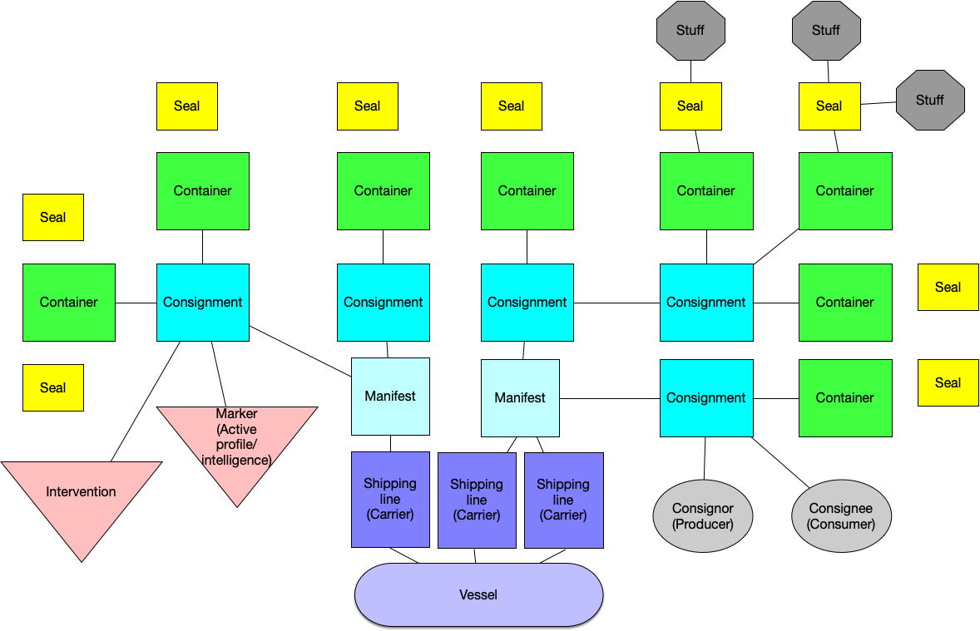
Domain knowledge – configuration of a ship

Slide 21
What kind of knowledge do we want to represent? Across the ecosystem
Declarative (use case specific) – what things exist and how do they relate to each other?
Entity graph: People and Things
Information graph: scalar values and schemas used
Note: this makes knowledge explicit and shareable -> URIs vs. DIDs
Temporal (ecosystem and use case specific) – what has happened over time?
Journey events (use case specific)
Assurance events (use case specific and ecosystem)
Data access events (ecosystem)
Instructive (ecosystem) – what are you allowed to do / obliged to do?
Permissioning and access management
Contracting, accounting and settlement
Other workflows (e.g. notification), including acting “on behalf of” other actors
Asserted and inferred (ecosystem) – who has said what, when (and why)?

Slide 22
Section 5
Look forward to Workshop 5

